Slide 1
Acalabrutinib vs Idelalisib plus Rituximab or Bendamustine plus Rituximab in Relapsed/Refractory Chronic Lymphocytic Leukemia: ASCEND Final Results
Abstract 3140
Paolo Ghia,¹ Andrzej Pluta,² Malgorzata Wach,³ Daniel Lysak,⁴ Tomas Kozak,⁵ Martin Simkovic,⁶ Iryna Kraychok,⁷ Arpad Illes,⁸ Javier de la Serna,⁹ Sean Dolan,¹⁰ Philip Campbell,¹¹ Gerardo Musuraca,¹² Abraham Jacob,¹³ Eric J. Avery,¹⁴ Jae Hoon Lee,¹⁵ Denise Wang,¹⁶ Priti Patel,¹⁶ Wojciech Jurczak¹⁷
¹Università Vita-Salute San Raffaele and IRCCS Ospedale San Raffaele, Milano, Italy; ²Department of Hematological Oncology, Oncology Specialist Hospital, Brzozow, Poland; ³Department of Hemato-Oncology and Bone Marrow Transplantation, Medical University of Lublin, Lublin, Poland; ⁴Fakultní Nemocnice Plzen, Pilsen, Czech Republic; ⁵Fakultní Nemocnice Královske Vinohrady, Prague, Czech Republic; ⁶University Hospital Hradec Kralove, Charles University, Hradec Kralove, Czech Republic; ⁷National Cancer Institute, Kiev, Ukraine; ⁸University of Debrecen, Faculty of Medicine, Department of Hematology, Debrecen, Hungary; ⁹Hospital Universitario, Madrid, Spain; ¹⁰Saint John Regional Hospital, University of New Brunswick, New Brunswick, Canada; ¹¹Barwon Health, University Hospital Geelong, Geelong, Victoria, Australia; ¹²Istituto Scientifico Romagnolo per lo Studio e la Cura dei Tumori, Meldola, Italy; ¹³The Royal Wolverhampton NHS Trust, Wolverhampton, United Kingdom; ¹⁴Nebraska Hematology Oncology, Lincoln, Nebraska, United States; ¹⁵Gachon University Gil Medical Center, Incheon, Korea, Republic of (South); ¹⁶Acerta Pharma, South San Francisco, California, United States; ¹⁷Maria Sklodowska-Curie National Research Institute of Oncology, Krakow, Poland

Slide 2
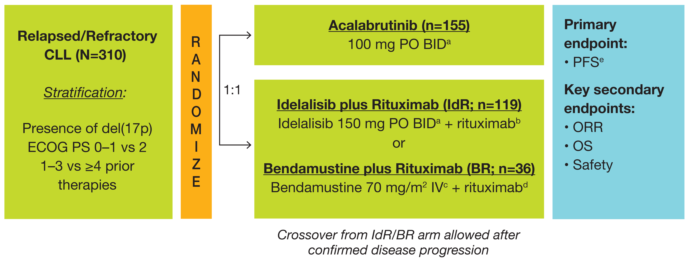
Introduction and Methods
ASCEND Study Design
Acalabrutinib is a next-generation, highly selective, covalent BTK inhibitor that has demonstrated efficacy in both TN and RR CLL^{1,2}
In a pre-planned interim analysis of ASCEND in pts with RR CLL, acalabrutinib significantly improved PFS vs SOC treatments (IdR or BR) after a median follow-up of 16.1 months³
We report final results from ASCEND after a median follow-up of 22 months
Key inclusion criteria: age ≥18 yrs, CLL diagnosis per IWCLL,⁴ ≥1 prior CLL therapy, ECOG PS ≤2
Key exclusion criteria: CNS lymphoma/leukemia, significant CV disease, prior BCL-2 or BCR inhibitor use
The data cutoff date for this analysis was August 1, 2019
Prior bendamustine was allowed if the investigator’s choice for treatment was IdR; bendamustine retreatment was allowed if the prior response to bendamustine lasted >24 months.
ªUntil progression or toxicity.
^{b}375 mg/m² IV on day 1 of the first cycle, then subsequent doses at 500 mg/m² every 2 weeks for 4 infusions followed by every 4 weeks for 3 infusions.
^{c}On day 1 and day 2 of cycles 1–6.
^{d}375 mg/m² IV on day 1 of the first cycle, then subsequent doses at 500 mg/m² on day 1 of cycles 2–6.
^{e}PFS was based only on investigator assessment after the interim analysis, when the primary endpoint of independent review committee-assessed PFS was met.
BCL-2, B-cell lymphoma 2; BCR, B-cell receptor; BID, twice daily; BR, bendamustine plus rituximab; BTK, Bruton tyrosine kinase; CLL, chronic lymphocytic leukemia; CNS, central nervous system; ECOG PS, Eastern Cooperative Oncology Group performance status; IdR, idelalisib plus rituximab; IV, intravenous; IWCLL, International Workshop on Chronic Lymphocytic Leukemia; ORR, overall response rate; OS, overall survival; PFS, progression-free survival; PO, orally; pts, patients; RR, relapsed/refractory; SOC, standard of care; TN, treatment-naïve.
1. Sharman JP, et al. Lancet. 2020;395(10232):1278-91. 2. Byrd JC, et al. Blood. 2020;135(15):1204-13. 3. Ghia P, et al. J Clin Oncol. 2020;38(25):2849-61. 4. Hallek M, et al. Blood. 2008;111(12):5446-56.
2

Slide 3
Patients, Exposure, and Disposition
Demographics and baseline characteristics have been previously published¹
Characteristic | Acalabrutinib (n=154) | IdR (n=118) | BR (n=35)
Duration of exposure, median (range), mo | 21.9 (1.1–27.9) | 11.5 (0.1–27.2)ª | 5.6 (1.0–7.1)^{b}
% relative dose intensity, median (range) | 99.3 (48.3–100.0) | 90.0 (46.6–100.0)ª | 96.4 (14.5–102.5)^{b}
Patients who discontinued treatment, n (%) | 42 (27) | 92 (77) | 7 (19)
Reasons for treatment discontinuation, n (%)
Adverse event | 24 (16) | 66 (56) | 6 (17)
Progressive disease | 16 (10) | 17 (14) | 1 (3)
Death | 1 (1) | 0 | 0
Investigator discretion | 0 | 5 (4) | 0
Withdrawal of consent | 0 | 1 (1) | 0
Other | 1 (1) | 3 (3) | 0
Received ≥6 IV treatment cycles, n (%) | NA | NA | 29 (83)^{b}
Richter transformation occurred in 4 pts (3%) in the acalabrutinib arm and 5 pts (3%) in the IdR/BR arm (IdR, n=4; BR, n=1)
3 pts were randomized but not treated (acalabrutinib, n=1; IdR, n=1; BR, n=1) and are not included in this table. ªIdelalisib only. ^{b}Bendamustine only. BR, bendamustine plus rituximab; IdR, idelalisib plus rituximab; IV, intravenous; NA, not applicable.
1. Ghia P, et al. J Clin Oncol. 2020;38(25):2849-2861.

Slide 4
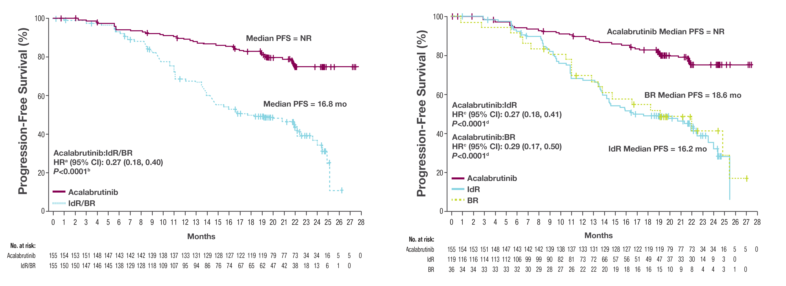
Acalabrutinib Prolonged Investigator-Assessed PFS
After a median of 22 months, acalabrutinib prolonged PFS vs investigator’s choice therapy (estimated 18-month PFS: 82% and 48%, respectively)
PFS for Acalabrutinib vs IdR/BR
PFS for Acalabrutinib vs IdR or BR
ªHazard ratio was based on stratified Cox-Proportional-Hazards model, stratified by randomization stratification factors as recorded in an interactive voice/web response system.
^{b}P-value was based on stratified log-rank test, stratified by randomization stratification factors as recorded in an interactive voice/web response system.
^{c}Hazard ratios were based on unstratified Cox-Proportional-Hazards model.
^{d}P-values were based on unstratified log-rank test.
PFS rates were based on the IWCLL 2008 criteria in pts with RR CLL.¹ Pts were censored at the time when any subsequent anticancer therapies were received.
BR, bendamustine plus rituximab; CI, confidence interval; HR, hazard ratio; IdR, idelalisib plus rituximab; IWCLL, International Workshop on Chronic Lymphocytic Leukemia; NR, not reached; PFS, progression-free survival; pts, patients; RR, relapsed/refractory.
1. Hallek M, et al. Blood. 2008;111(12):5446-56.
4

Slide 5
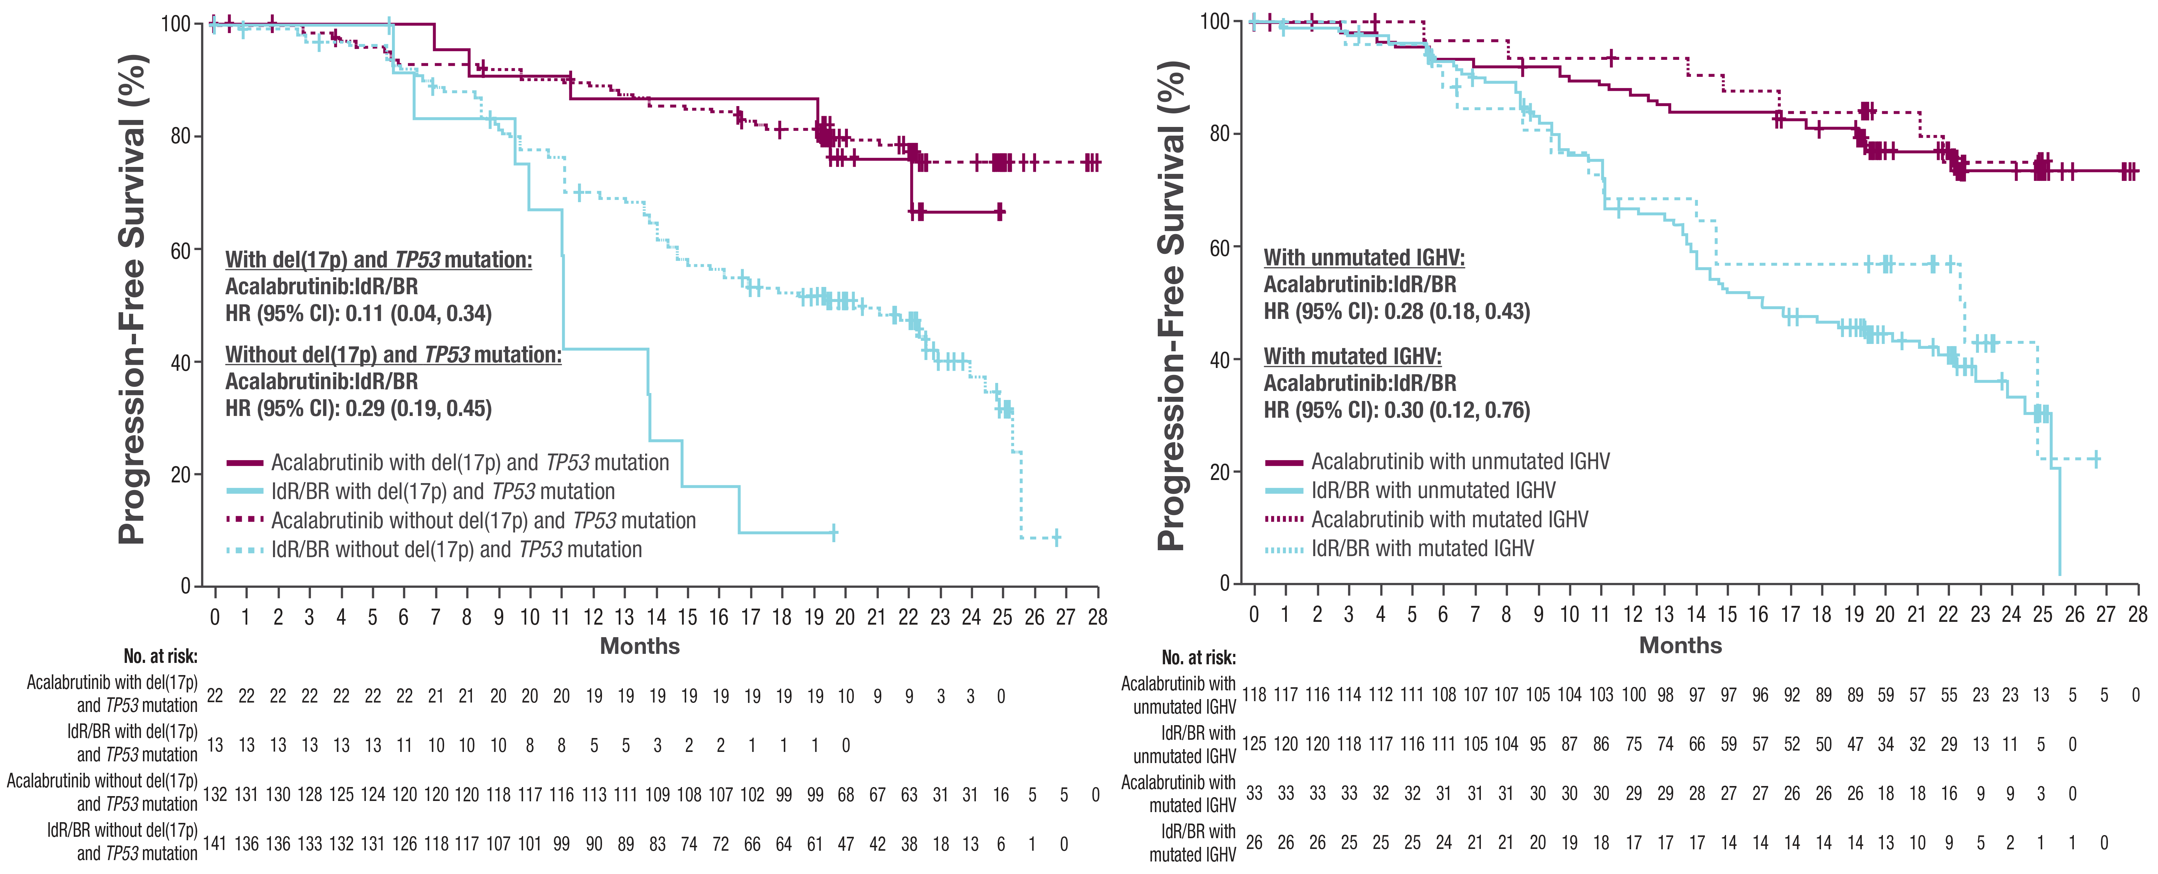
Acalabrutinib Prolonged Investigator-Assessed PFS in Patients With High-Risk Genetic Features
Acalabrutinib also prolonged PFS in pts with del(17p) and TP53 mutations, unmutated IGHV (below) and in other prespecified subgroups
PFS in Patients With del(17p) and TP53 Mutations
PFS in Patients With Unmutated IGHV
5
PFS rates were based on the IWCLL 2008 criteria in pts with RR CLL.¹ Pts were censored at the time when any subsequent anticancer therapies were received.
BR, bendamustine plus rituximab; CI, confidence interval; HR, hazard ratio; IdR, idelalisib plus rituximab; IGHV, immunoglobulin heavy chain variable; PFS, progression-free survival; pts, patients; RR, relapsed/refractory.
1. Hallek M, et al. Blood. 2008;111(12):5446-56.

Slide 6
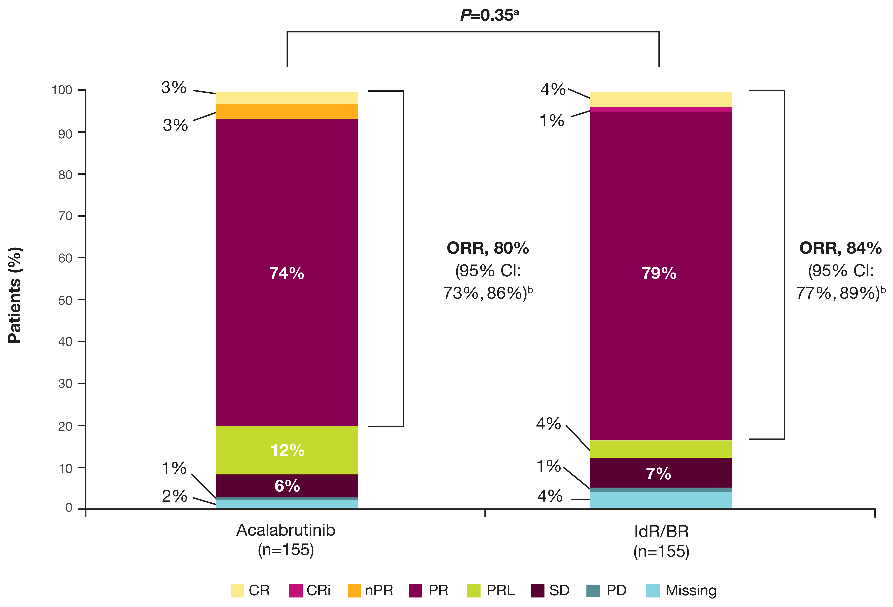
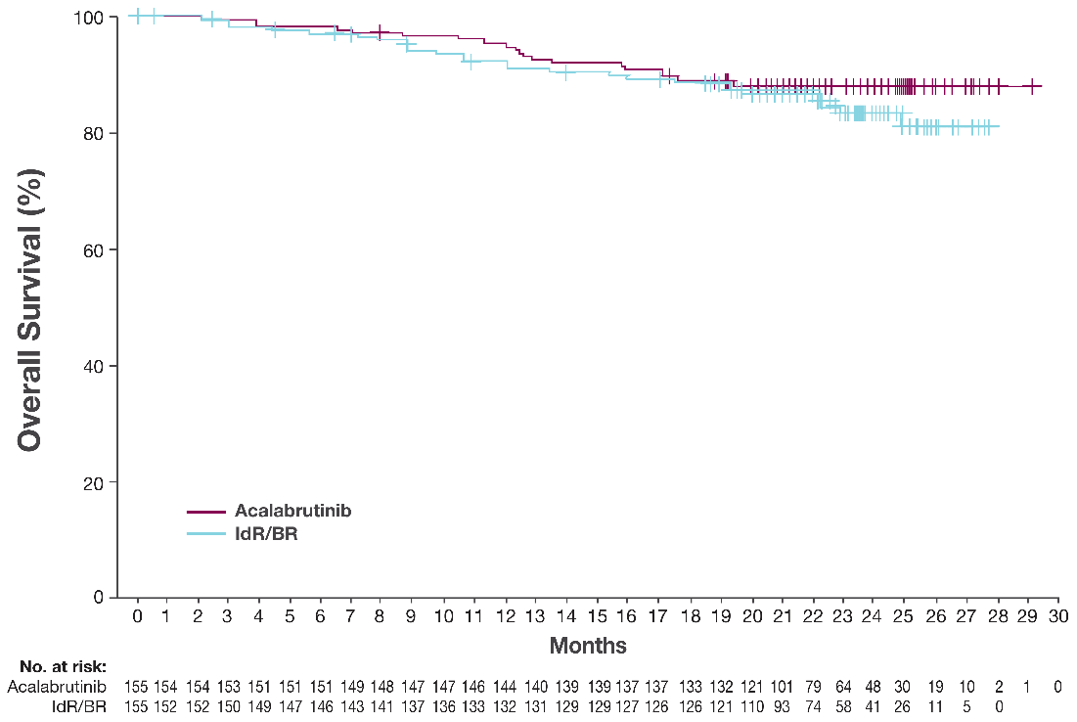
Median OS and DOR Were Not Reached With Acalabrutinib
Median OS was not reached in either treatment arm
DOR was longer with acalabrutinib vs IdR/BR (median: NR vs 18.0 months; HR [95% CI]: 0.19 [0.11, 0.33])
Estimated 18-month DOR rate: 85.4% (95% CI: 77, 91) vs 49.4% (95% CI: 40, 58)
P=0.35^{c}
Acalabrutinib:IdR/BR HRª (95% CI): 0.78 (0.44, 1.40) P=0.4094^{b}
Estimated 18-mo OS rate: Acalabrutinib, 88% (95% CI: 81%, 92%) IdR/BR, 88% (95% CI: 81%, 92%)
ORR, 80%
(95% CI: 73%, 86%)^{d}
ORR, 84%
(95% CI: 77%, 89%)^{d}
ORR + PR with lymphocytosis was 92% (95% CI: 86, 95) for acalabrutinib and 88% (95% CI: 82, 92) for IdR/BR. Response rates were based on the International Workshop on Chronic Lymphocytic Leukemia (IWCLL) 2008 criteria.¹
ªHazard ratio was based on stratified Cox-Proportional-Hazards model, stratified by randomization stratification factors as recorded in an interactive voice/web response system.
^{b}P-value was based on stratified log-rank test, stratified by randomization stratification factors as recorded in an interactive voice/web response system.
^{c}Based on Cochran-Mantel-Haenszel test with adjustment for randomization stratification factors as recorded in an interactive voice/web response system.
^{d}95% confidence interval based on Normal approximation (with use of Wilson’s score). BR, bendamustine plus rituximab; CI, confidence interval; CR, complete response; CRi, complete response with incomplete blood count recovery; DOR, duration of response; HR, hazard ratio; IdR, idelalisib plus rituximab; nPR, nodular partial response; NR, not reached; ORR, overall response rate; OS, overall survival; PD, progressive disease; PR, partial response; PRL, partial response with lymphocytosis; SD, stable disease.
1. Hallek M, et al. Blood. 2008;111(12):5446-56.

Slide 7
Improved Safety Profile With Acalabrutinib vs IdR/BR
Grade ≥3 AEs (IdR, 90%; acalabrutinib, 55%; BR, 49%), serious AEs (56%; 33%; 26%),ª treatment-related AEs (95%; 70%; 69%), and AEs leading to drug discontinuations (59%; 14%; 17%) or dose withholdings (66%; 38%; 20%) were higher with IdR vs acalabrutinib or BR
 | Acalabrutinib (n=154) |  | IdR (n=118) |  | BR (n=35)
Most common AEs, n (%)^{b} | Any | Grade ≥3 | Any | Grade ≥3 | Any | Grade ≥3
Headache | 34 (22) | 1 (1) | 7 (6) | 0 | 0 | 0
Neutropenia | 33 (21) | 26 (17) | 54 (46) | 47 (40) | 12 (34) | 11 (31)
Diarrhea | 30 (20) | 3 (2) | 58 (49) | 29 (25) | 5 (14) | 0
URTI | 30 (20) | 3 (2) | 19 (16) | 4 (3) | 4 (11) | 1 (3)
Cough | 25 (16) | 0 | 18 (15) | 1 (1) | 2 (6) | 0
Anemia | 24 (16) | 19 (12) | 11 (9) | 8 (7) | 4 (11) | 3 (9)
Pyrexia | 21 (14) | 1 (1) | 22 (19) | 8 (7) | 6 (17) | 1 (3)
Pneumonia | 20 (13) | 10 (7) | 15 (13) | 11 (9) | 2 (6) | 1 (3)
Thrombocytopenia | 18 (12) | 6 (4) | 17 (14) | 9 (8) | 5 (14) | 1 (3)
Fatigue | 17 (11) | 2 (1) | 10 (9) | 1 (1) | 8 (23) | 1 (3)
Nausea | 11 (7) | 0 | 16 (14) | 1 (1) | 7 (20) | 0
ALT increased | 3 (2) | 2 (1) | 14 (12) | 10 (9) | 3 (9) | 1 (3)
AST increased | 3 (2) | 1 (1) | 11 (9) | 6 (5) | 2 (6) | 1 (3)
Neutrophil count decreased | 3 (2) | 2 (1) | 9 (8) | 9 (8) | 1 (3) | 1 (3)
Infusion-related reaction | 0 | 0 | 9 (8) | 2 (2) | 8 (23) | 1 (3)
Transaminases increased | 0 | 0 | 9 (8) | 7 (6) | 0 | 0
 | Acalabrutinib (n=154) |  | IdR/BR (n=153)
Events of clinical interest, n (%) | Any | Grade ≥3 | Any | Grade ≥3
Atrial fibrillation | 9 (6) | 2 (1) | 5 (3) | 2 (1)
Hemorrhage | 44 (29) | 4 (3) | 12 (8) | 4 (3)
Major hemorrhage^{c} | 5 (3) | 4 (3)^{d} | 4 (3) | 4 (3)^{e}
Hypertension | 7 (5) | 4 (3) | 6 (4) | 1 (1)
Infections | 97 (63) | 30 (20) | 99 (65) | 38 (25)
SPMs excluding NMSC | 8 (5) | 6 (4) | 3 (2) | 2 (1)
Tumor lysis syndrome | 1 (1) | 1 (1) | 1 (1) | 1 (1)
ªSerious AEs in ≥5% of pts in any group included pneumonia (acalabrutinib, 6%, IdR, 10%, BR, 3%), diarrhea (acalabrutinib, 1%, IdR, 14%, BR, 0), and pyrexia (acalabrutinib, 1%, IdR, 7%, BR, 3%).
^{b}Occurring in ≥15% (any grade) or ≥5% (grade ≥3) of pts in any cohort.
^{c}Major hemorrhage was defined as any serious or grade ≥3 hemorrhage or central nervous system hemorrhage of any grade.
^{d}Includes events of grade 4 GI hemorrhage (n=1), grade 3 GI hemorrhage (n=1), grade 4 immune thrombocytopenic purpura (n=1), and grade 3 intestinal hemorrhage (n=1).
^{e}Includes events of grade 3 GI hemorrhage (n=1), grade 3 and grade 4 immune thrombocytopenic purpura (n=1), grade 3 hematuria (n=1), and grade 3 hemorrhagic anemia and grade 3 tumor hemorrhage (n=1).
AEs were graded according to the Common Toxicity Criteria of the National Cancer Institute, version 4.03. AE, adverse event; ALT, alanine aminotransferase; AST, aspartate aminotransferase; BR, bendamustine plus rituximab; GI, gastrointestinal; IdR, idelalisib plus rituximab; NMSC, non-melanoma skin carcinoma; SPM, second primary malignancy; URTI, upper respiratory tract infection.

Slide 8
Conclusions
Final results from ASCEND confirm findings at interim analysis¹ and support the favorable efficacy and safety of acalabrutinib vs SOC regimens in RR CLL
PFS was prolonged with acalabrutinib vs IdR/BR, regardless of genetic characteristics
Median OS and DOR were NR with acalabrutinib after a median follow-up of 22 months
Fewer pts treated with acalabrutinib than IdR discontinued treatment due to AEs
Overall, these data from the ASCEND study support use of acalabrutinib in pts with RR CLL, including pts with high-risk features
Copies of this poster obtained through Quick Response Code are for personal use only and may not be reproduced without permission from the author of this poster.
AEs, adverse events; BR, bendamustine plus rituximab; CLL, chronic lymphocytic leukemia; DOR, duration of response; IdR, idelalisib plus rituximab; NR, not reached; OS, overall survival; PFS, progression-free survival; pts, patients; RR, relapsed/refractory; SOC, standard of care
1. Ghia P, et al. J Clin Oncol. 2020;38(25):2849-61.
Author contact: ghia.paolo@hsr.it

Slide 9
Disclosures
Paolo Ghia: Consultancy, Honoraria Consultancy, Honoraria: AbbVie, Adaptive, ArQule/MSK, Acerta/AstraZeneca, BeiGene, Celgene/Juno, Janssen, Lilly/Loxo, MEI. Research Funding: AbbVie, Janssen, Gilead, Novartis, Sunesis. Andrzej Pluta: Travel, Accommodations, Expenses: Celgene; Honoraria: Celgene, Servier, Takeda, Novartis; Research Funding: Janssen-Cilag, Kartos Therapeutics, Iqvia, Roche, Acerta Pharma, Pharmacyclics, BeiGene, Takeda. Malgorzata Wach, Sean Dolan, Jae Hoon Lee: No relationships to disclose. Daniel Lysak: Consulting or Advisory Role: AbbVie, Novartis, Roche, Janssen-Cilag. Tomas Kozak: Consulting or Advisory Role: Amgen, Novartis, AbbVie, Gilead Sciences; Travel, Accommodations, Expenses: AbbVie, Takeda. Martin Simkovic: Consulting or Advisory Role: AbbVie. Speakers’ Bureau: Janssen-Cilag, AbbVie. Travel, Accommodations, Expenses: Gilead Sciences, AbbVie, Janssen-Cilag; Honoraria: Janssen-Cilag, AbbVie/Genentech. Iryna Kraychok: Consulting or Advisory Role: Takeda, Janssen Oncology; Travel, Accommodations, Expenses: Takeda, Roche, AbbVie, MSD Oncology; Expert Testimony: Takeda, Janssen Oncology; Research Funding: Janssen Oncology, Bayer, Karyopharm Therapeutics, MSD Oncology, Acerta Pharma, AbbVie, Debiopharm Group. Arpad Illes: Consulting or Advisory Role/Honoraria: Janssen, Celgene, Takeda, Novartis Pharma SAS, Pfizer Pharmaceuticals Israel, Roche; Travel, Accommodations, Expenses: Novartis, Janssen, Pfizer, Roche; Research Funding: Takeda, Seattle Genetics. Javier De La Serna: Consulting or Advisory Role: AstraZeneca, AbbVie, Janssen; Speakers’ Bureau: AbbVie, Janssen; Travel, Accommodations, Expenses: AbbVie, AstraZeneca. Philip Campbell: Consulting or Advisory Role: AstraZeneca, Janssen, Roche, Amgen, CSL Behring, Novartis. Gerardo Musuraca: Consulting or Advisory Role: AstraZeneca, Debiopharm Group, Janssen, Gilead Sciences; Research Funding: TG Therapeutics, Acerta Pharma, AstraZeneca, Janssen, Bayer, Debiopharm Group, Epizyme, Merck, MorphoSys, MEI Pharma, Celerion, Roche, Servier, BeiGene. Abraham Jacob: Consulting or Advisory Role: AstraZeneca; Stock and Other Ownership Interests: AstraZeneca, GlaxoSmithKline, Midlands Haematology Services; Honoraria: AstraZeneca; Research Funding: AstraZeneca. Eric Joseph Avery: Consulting or Advisory Role: AstraZeneca; Travel, Accommodations, Expenses: AstraZeneca; Research Funding: Lilly. Denise Wang: Employment: Acerta Pharma LLC; Consulting or Advisory Role: Global Blood Therapeutics. Priti Patel: Employment/Stock Ownership: Acerta Pharma/AstraZeneca. Wojciech Jurczak: Consulting or Advisory Role: Janssen-Cilag, Roche, Gilead Sciences, AstraZeneca, Debiopharm Group, Epizyme; Research Funding: Acerta Pharma, Merck, Gilead Sciences, TG Therapeutics, Incyte, Bayer, Sandoz-Novartis, Roche, Celltrion, Takeda, Affimed Therapeutics, Epizyme, Janssen-Cilag, BeiGene, Debiopharm Group, Morphosys, MEI Pharma.
Acknowledgments
This study was sponsored by Acerta Pharma, South San Francisco, CA, a member of the AstraZeneca Group. Medical writing support was provided by Peloton Advantage, LLC (Parsippany, NJ, USA), an OPEN Health company and funded by Acerta Pharma, a member of the AstraZeneca Group
We thank all the patients, their families, and the investigators and their study teams who participated in this study

